Slide 1
CS 35L – Section 1
10/28/2013
Zhanyong Wang (Jerry)
zhanyongwang@ucla.edu
Office Hour:
9:00-11:00 Tuesday
BH 2432

Slide 2
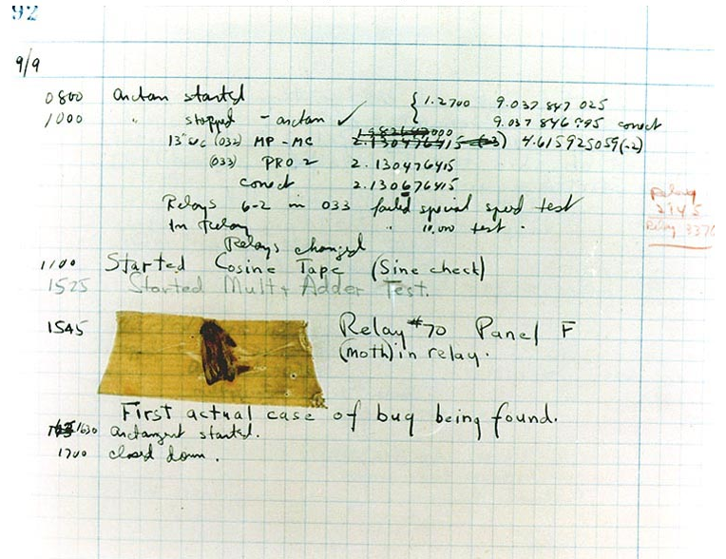
Bug and Debug
Bug: Errors in programs
Debug: Finding and eliminating errors from programs
Grace Hopper and the “First actual case of bug being found”

Slide 3
Debugging Process
Reproduce the bug
Simplify program input
Use a debugger to track down the origin of the problem
Fix the problem

Slide 4
Debugger
A program that is used to run and debug other (target) programs
Allows programmers to interact with and inspect the running program to trace the flow of execution and track down problems
Can step through source code line by line
  each line is executed on demand
If the program crashes a debugger outputs where and why the program crashed

Slide 5
GDB – GNU Debugger
Debugger for several languages
  C, C++, Java, Objective-C
Allows you to inspect what the program is doing at a certain point during execution
Logical errors and segmentation faults are easier to ﬁnd with the help of gdb

Slide 6
Using GDB
Compile Program
  Normally: gcc [flags] <source files> -o <output file>
  Debugging: gcc [other flags] –g <source files> -o <output file>
    enable built-in debugging support
Specify Program to Debug
  $ gdb <executable>
  or
  $ gdb
  (gdb) file <executable>

Slide 7
Using GDB
3. In GDB Interactive Shell
  Tab to Autocomplete, up-down arrows to recall history
  help [command] to get more info about a command
4. Run Program
  (gdb) run or
  (gdb) run [arguments]
5. Exit the gdb Debugger
  (gdb) quit

Slide 8
What If I Have Bugs?
Segmentation fault
  Program received signal SIGSEGV, Segmentation fault. 0x0000000000400524 in function (arr=0x7fffc902a270, r1=2, c1=5, r2=4, c2=6) at program.c:12
    Line number where it crashed and parameters to the function that caused the error
Logic Error
  Program will run and exit successfully
How do we find bugs?

Slide 9
Setting Breakpoints
Breakpoints
  used to stop the program run at a specific point
  If the program reaches that location when running, it will pause and prompt you for another command.
Example:
  (gdb) break [file1.c:]6
    Program will pause when it reaches line 6 of file1.c
  (gdb) break my_function
    Program will pause at the first line of my_function every time it is called
  (gdb) break [position] if expression
    Program will pause at specified position only when the expression evaluates to true

Slide 10
Conditional Breakpoints
break [position] if expression
(gdb) s
27 for ( i = 1; i <= limit ; ++i )
(gdb) break 28 if i == limit - 1
Breakpoint 1 at 0x4010e7: file gdb_test.c, line 28.

Slide 11
Breakpoints
You can set as many breakpoints as you want
  (gdb) info breakpoints/break/b shows a list of all breakpoints
Setting a breakpoint and running the program will stop program where you tell it to

Slide 12
Deleting, Disabling and Ignoring BPs
(gdb) delete [bp_number | range]
  Deletes the specified breakpoint or range of breakpoints
(gdb) disable [ bp_number | range]
  Temporarily deactivates a breakpoint or a range of breakpoints
(gdb) enable [ bp_number | range]
  Restores disabled breakpoints
If no arguments are provided to the above commands, all breakpoints are affected
(gdb) ignore bp_number iterations
  Instructs GDB to pass over a breakpoint without stopping a certain number of times.
    bp_number: the number of a breakpoint
    Iterations: the number of times you want it to be passed over

Slide 13
Resuming Execution After a Break
When a program stops at a breakpoint
  4 possible kinds of gdb operations:
    c or continue: debugger will continue executing until next breakpoint
    n or next: debugger will execute the next line as single instruction
    s or step: same as next but functions are executed line by line instead of as a single instruction
    f or finish: debugger will resume execution until the current function returns. Execution stops immediately after the program flow returns to the function's caller
      the function's return value and the line containing the next statement are displayed

Slide 14
Displaying Data
Interrupting execution allows us to see data at run-time:
  (gdb) print [/format] [expression]
    Prints the value of the specified expression in the specified format
  Formats:
    d: Decimal notation (default format for integers)
    x: Hexadecimal notation
    o: Octal notation.
    t: Binary notation
    c: character

Slide 15
Watchpoints
Breakpoints interrupt the program at a particular line or function, watchpoints act on variables
  (gdb) watch my_var
    sets a watchpoint on my_var
    the debugger stops the program when the value of my_var changes.
    old and new values will be printed
  (gdb) rwatch expression
    The debugger stops the program whenever the program reads the value of any object involved in the evaluation of expression
  (gdb) awatch expression
    The debugger stops the program whenever the program reads or modifies the value of any object involved in the evaluation of expression.

Slide 16
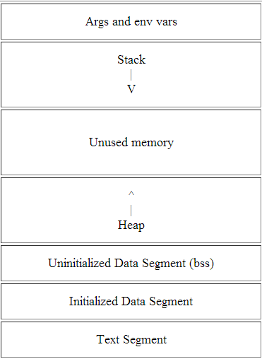
Process Memory Layout
Command line arguments and environment variables
Grows downward as a result of a newly called function.
grows upward when dynamic memory is requested by C’s malloc() or C++’s new
Uninitialized global variables
Initialized global variables
code to be executed

Slide 17
Stack Info
A program is made up of one or more functions which interact by calling each other.
Every time a function is called, an area of memory is set aside for it. This area of memory is called a stack frame and holds the following crucial info:
  storage space for all the automatic variables for the newly called function
  the line number of the calling function to return to when the called function returns
  the arguments, or parameters, of the called function
Each function call gets its own stack frame. Collectively, all the stack frames make up the call stack

Slide 18
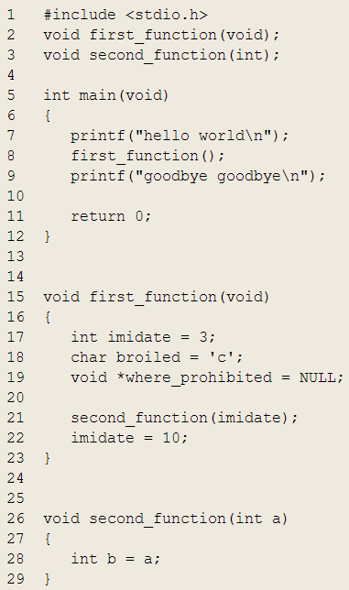
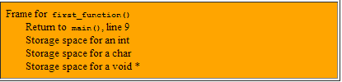

Stack Frames and the Stack
Program Ends
When first_function() returns, its frame is used to determine where to return to (line 9 of main()), then deallocated and returned to the stack
Call to second_function() is made, unused stack memory is used to create a stack frame for second_function(). The frame holds 3 things: storage space for an int and the current address of execution within second_function()
One stack frame belonging to main():
Uninteresting since main() has no automatic variables, no parameters, and no function to return to
Call to first_function() is made, unused stack memory is used to create a frame for first_function(). It holds four things: storage space for an int, a char, and a void *, and the line to return to within main()
When second_function() returns, its frame is used to determine where to return to (line 22 of first_function()), then deallocated and returned to stack.
When main() returns, the program ends

Slide 19
Analyzing the Stack in GDB
(gdb) backtrace/bt
  Shows the call trace (the call stack)
  Without function calls:
    #0 main () at program.c:10
    one frame on the stack, numbered 0, and it belongs to main()
  After call to function display()
    #0 display (z=5, zptr=0xbffffb34) at program.c:15
    #1 0x08048455 in main () at program.c:10
    Two stack frames: frame 1 belonging to main() and frame 0 belonging to display().
    Each frame listing gives
      the arguments to that function
      the line number that's currently being executed within that frame

Slide 20
Analyzing the Stack
(gdb) info frame
  Displays information about the current stack frame, including its return address and saved register values
(gdb) info locals
  Lists the local variables of the function corresponding to the stack frame, with their current values
(gdb) info args
  List the argument values of the corresponding function call

Slide 21
Debugging Example

Slide 22
Lab 5
Download old version of coreutils with buggy ls program
  Untar, configure, make
Bug: ls -t mishandles files whose time stamps are very far in the past. It seems to act as if they are in the future
$ touch -d ‘1918-11-11 11:00 GMT’ wwi-armistice
$ touch now
$ sleep 1
$ touch now1
$ ls -lt wwi-armistice now now1
Output:
-rw-r--r-- 1 eggert eggert 0 Nov 11 1918 wwi-armistice
-rw-r--r-- 1 eggert eggert 0 Oct 27 15:57 now1
-rw-r--r-- 1 eggert eggert 0 Oct 27 15:57 now

Slide 23
Goal: Fix the Bug
Reproduce the Bug
  SEASnet NFS servers have unsigned 32-bit time stamps
  Local File System on Linux server has signed 32-bit time stamps
  If you touch the files on the NFS servers it will return timestamp around 2054
Work-Around
  Touch files on local file system
  type “df –l” to find out which directories belong to the local file system “/tmp”
  Use Ubuntu
Simplify input
  Run ls with –l and –t options only

Slide 24
Steps:
Get the older version
wget
http://cs.ucla.edu/classes/fall13/cs35L/assign/coreutils-with-bug.tar.gz
Built
  ./configure
  ./make
  patch

Slide 25
Fix the Bug
Debug
  Use gdb to figure out what’s wrong
  $ gdb ls
  (gdb) run –lt wwi-armistice now now1
  (run from the directory where the compiled ls lives)
Patch
  Construct a patch “lab5.diff” containing your fix
  It should contain a ChangeLog entry followed by the output of diff -u

